Slide 1
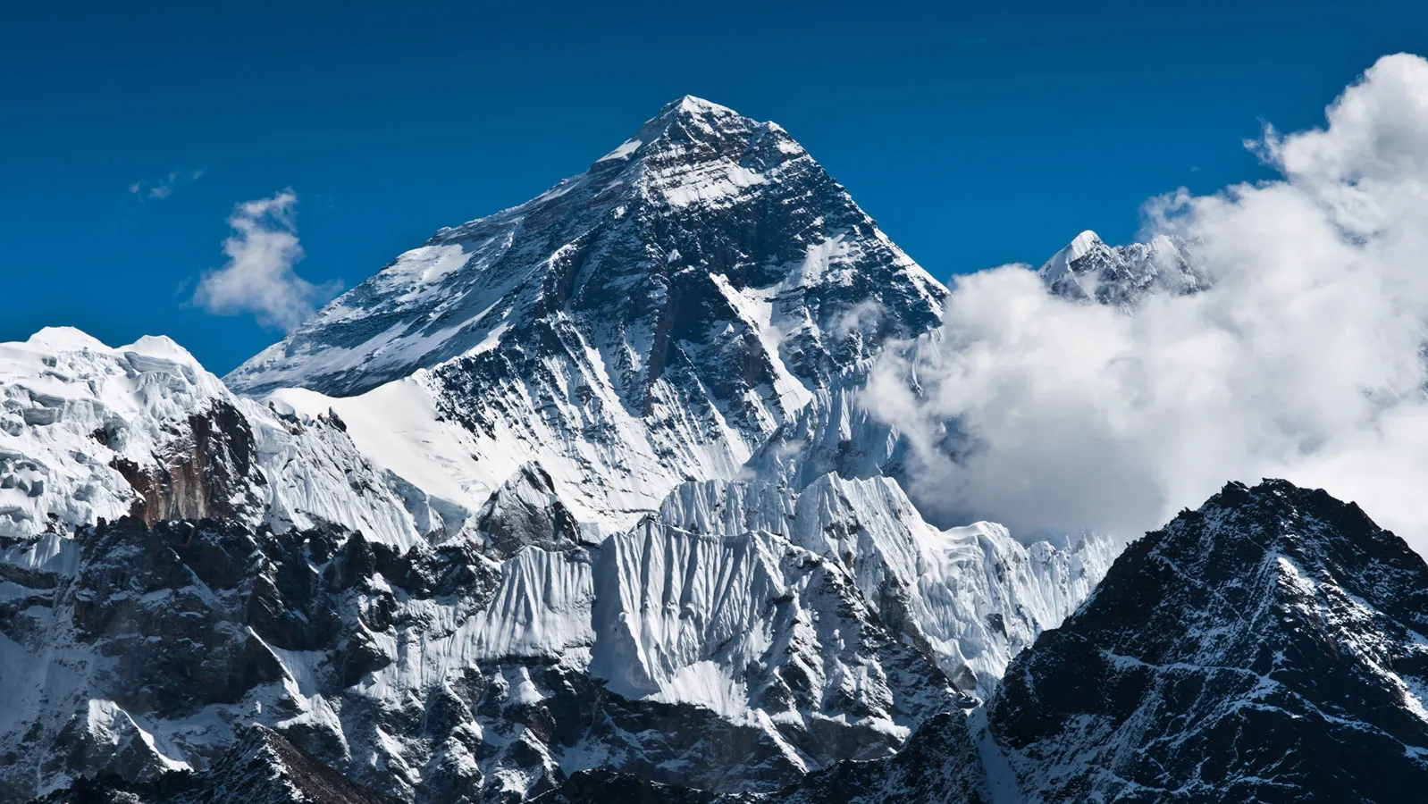
Which is Greater?
Derek Knight

Slide 2
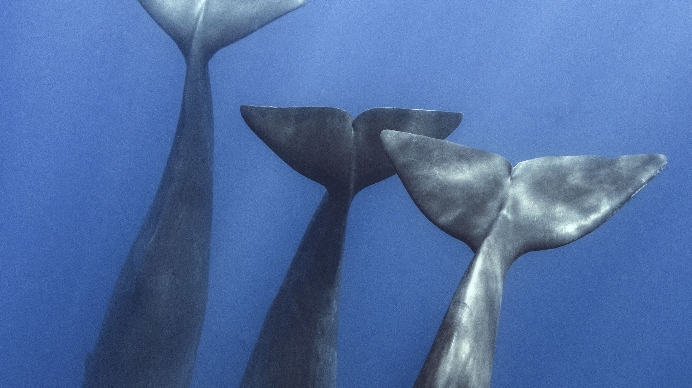
Which is Heavier?
50 African Elephants vs a Blue Whale

Slide 3
50 African Elephants
50 African Elephants $= 300 000 kg$
Blue whale $= 100 000 kg$

Slide 4
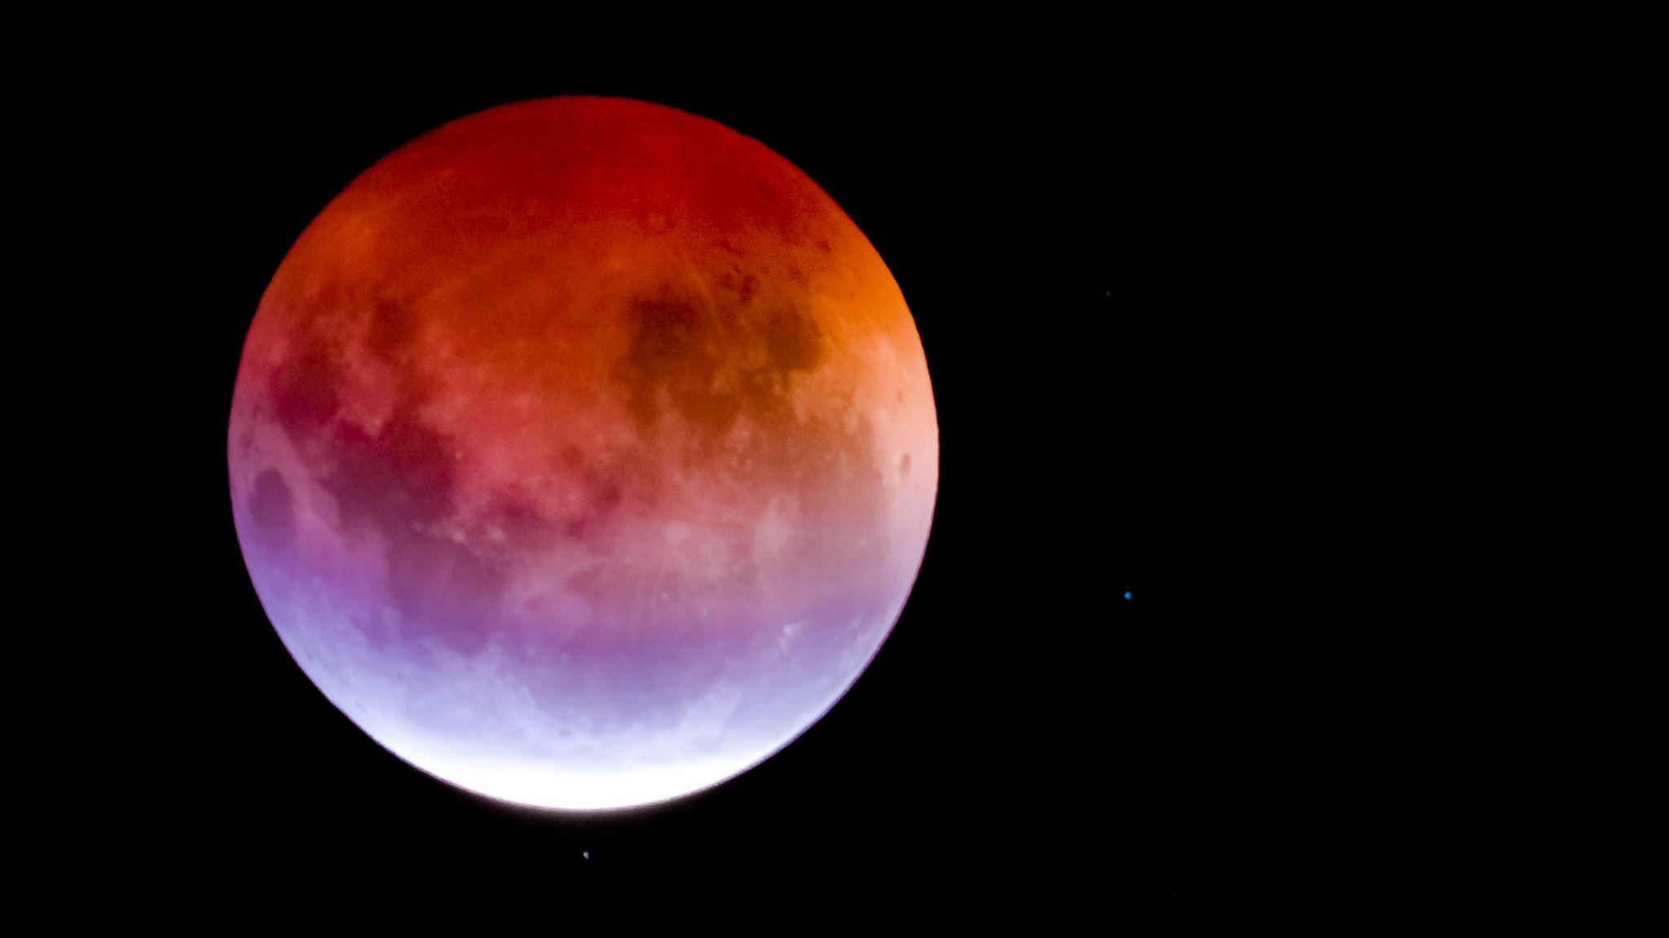
Which is larger?
The moon vs Pluto

Slide 5
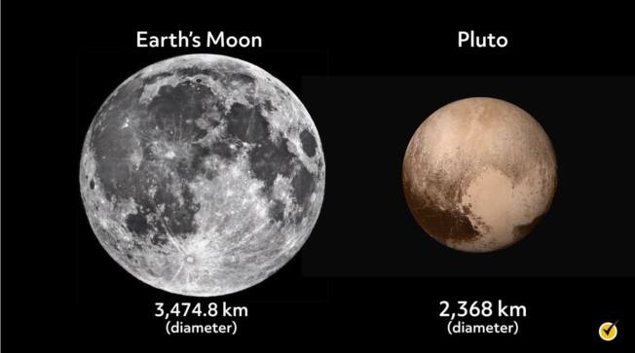
The moon

Slide 6
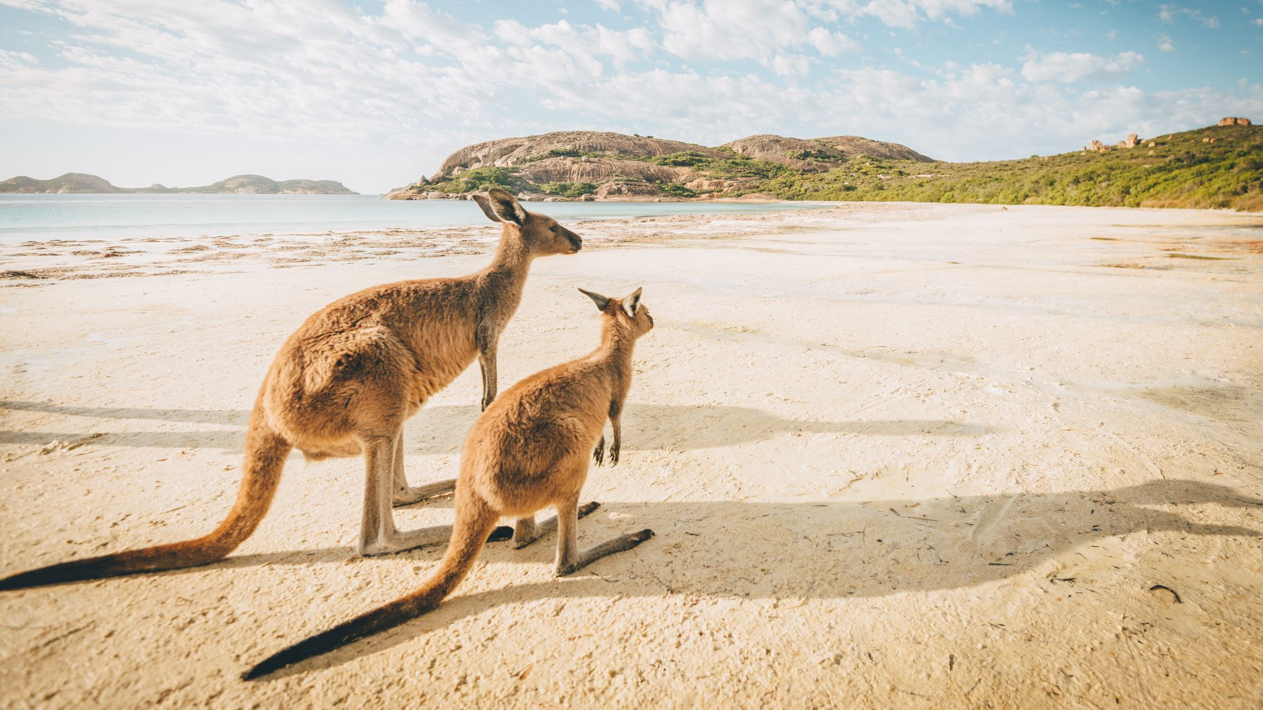
Who is faster?
Usain Bolt vs Kangaroo

Slide 7
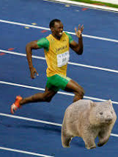
Kangaroo
Usain Bolt $= 44 km/hr.$
Kangaroo $= 50 – 70 km/hr.$

Slide 8
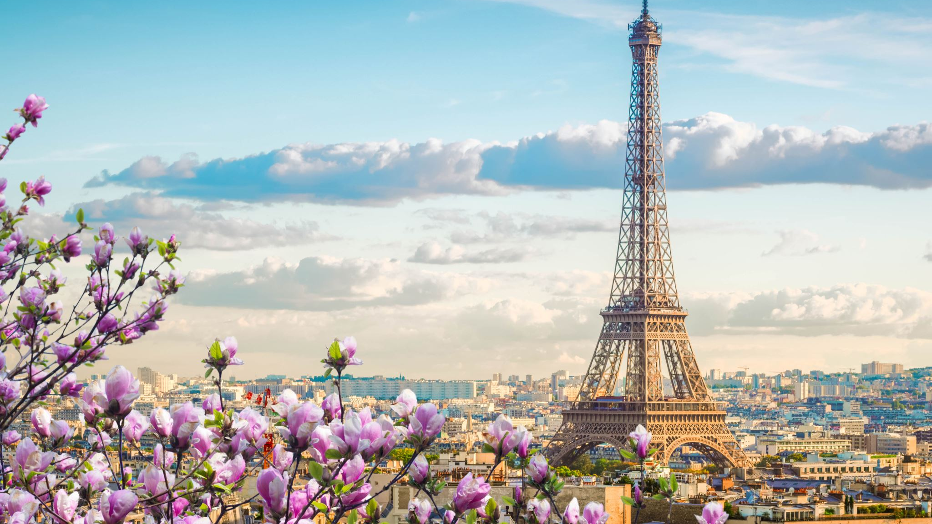
Which is taller?
Eiffel Tower vs CN Tower

Slide 9
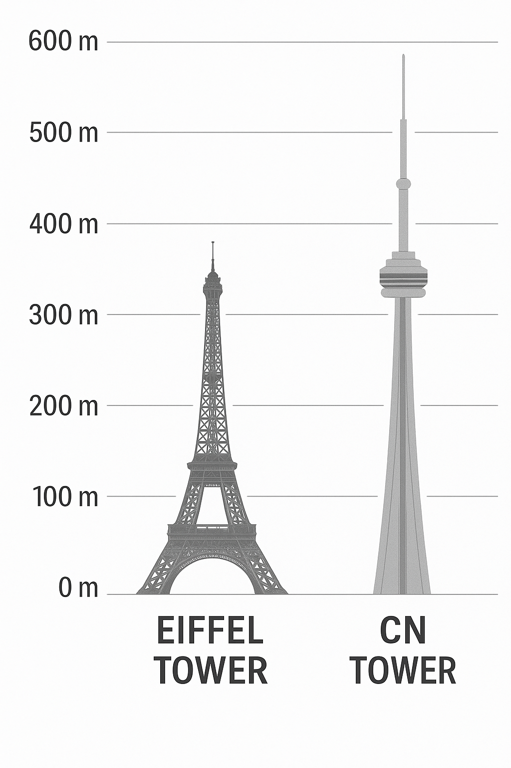
CN Tower
Eiffel Tower $= 330 m$
CN Tower $= 553 m$

Slide 10
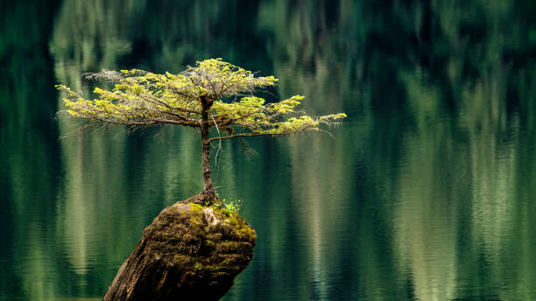
Which is larger?
BC vs California

Slide 11
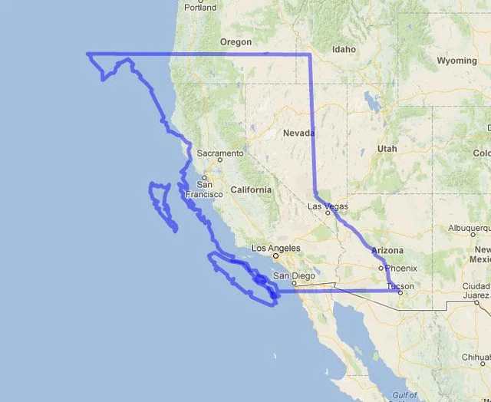
BC
BC = $944 735 km^{2}$
California =$423 970 km^{2}$

Slide 12
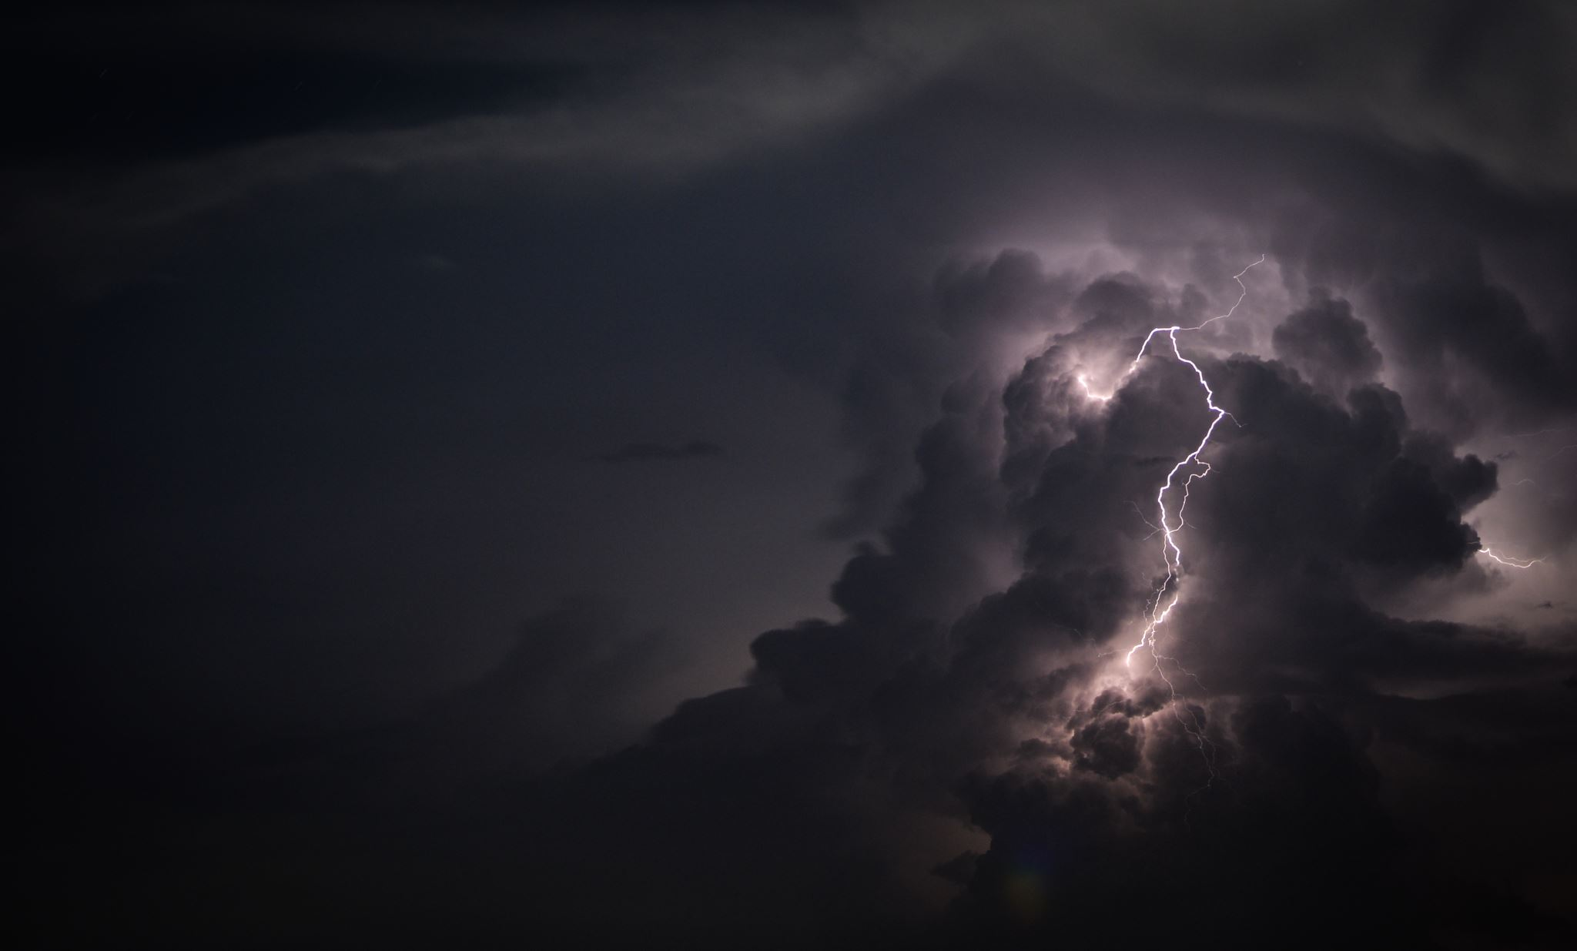
Which is hotter?
The Sun vs Lightning

Slide 13
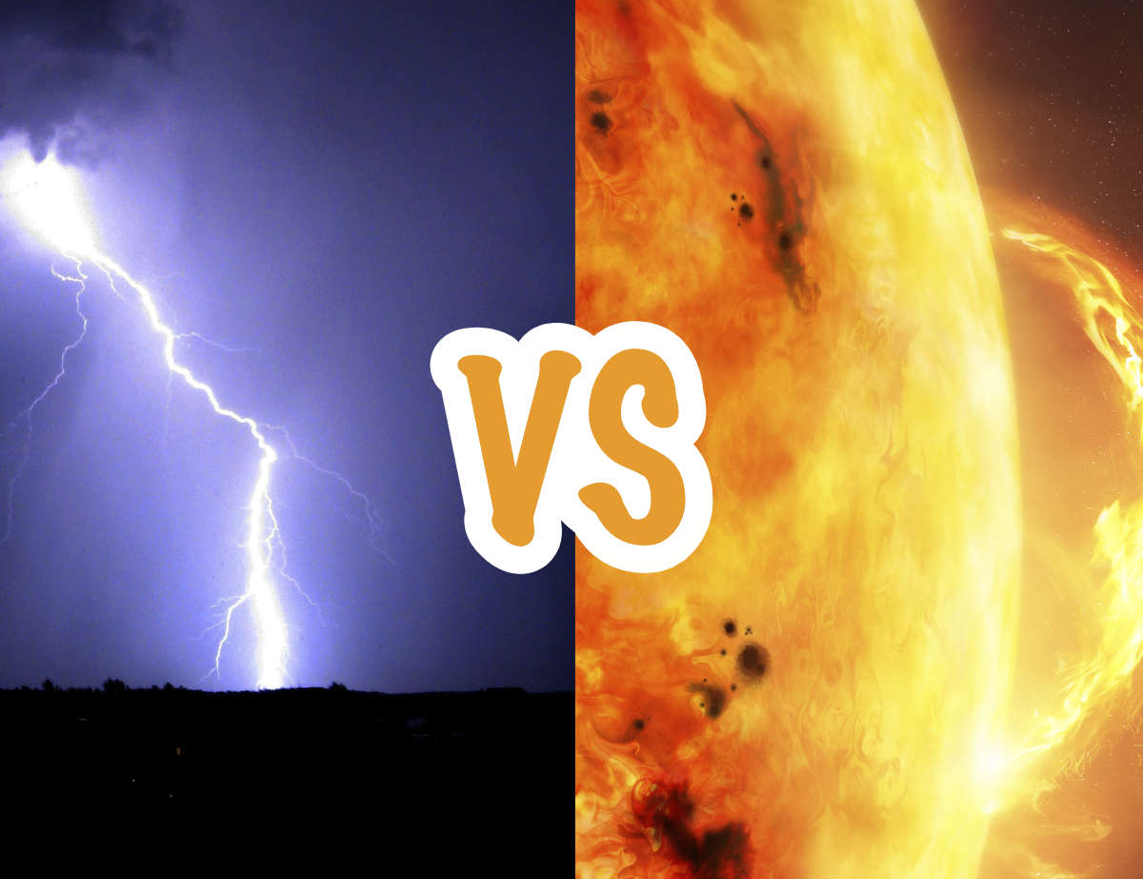
Lightning
The Sun $= 5 500 C$
Lightning $= 27 700 C$

Slide 14
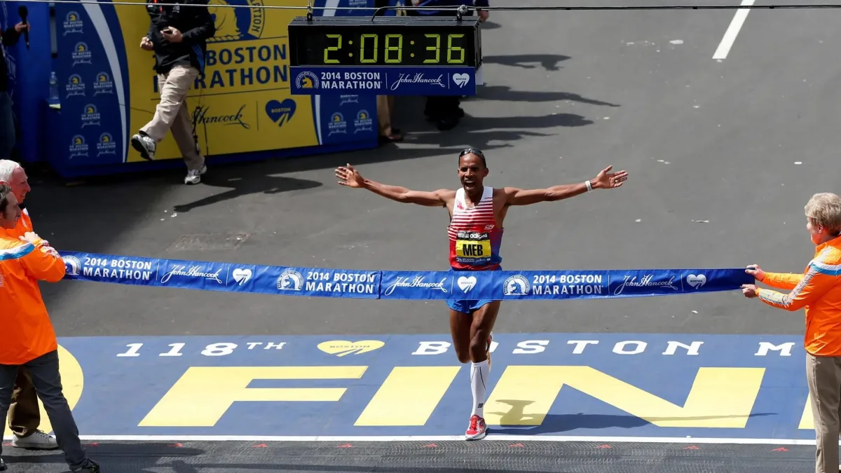
Which is longer?
A Marathon vs 1 000 000 cm

Slide 15
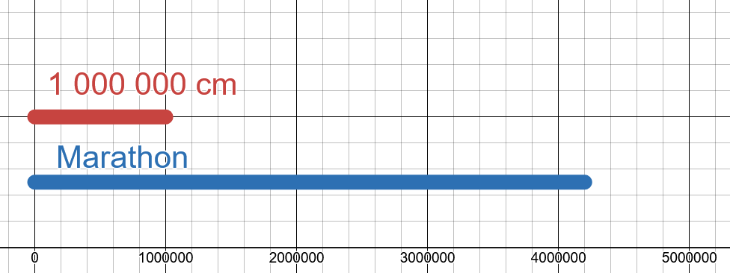
Marathon
Marathon $= 42 km = 42 000 m = 4 200 000 cm$
1 000 000 cm $= 1 000 000 cm$

Slide 16
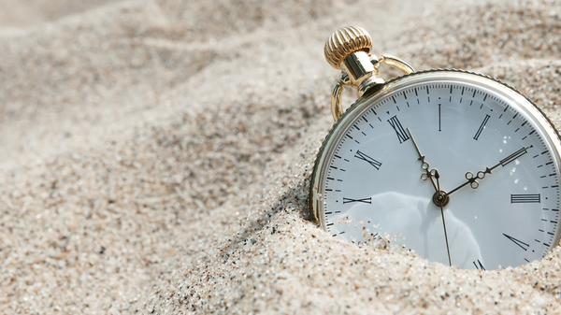
Which is greater?
Number of seconds in a day vs number of minutes in a year

Slide 17
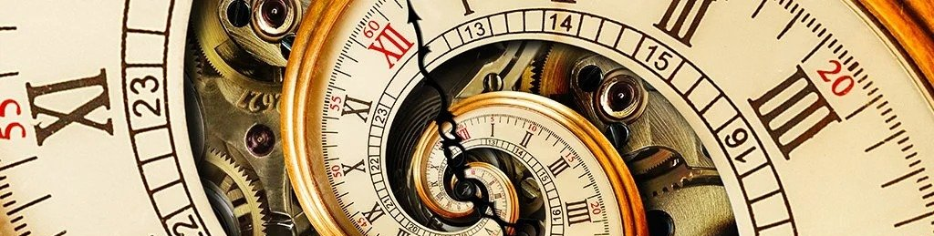
Number of Minutes in a Year
Number of seconds in a day $= 24\frac{hr}{day} = 1 440\frac{mins}{day} = 86 400 \frac{seconds}{day}$
number of minutes in a year $= 365\frac{days}{year} = 8 760\frac{hrs}{year} = 525 600 \frac{Minutes}{year}$

Slide 18
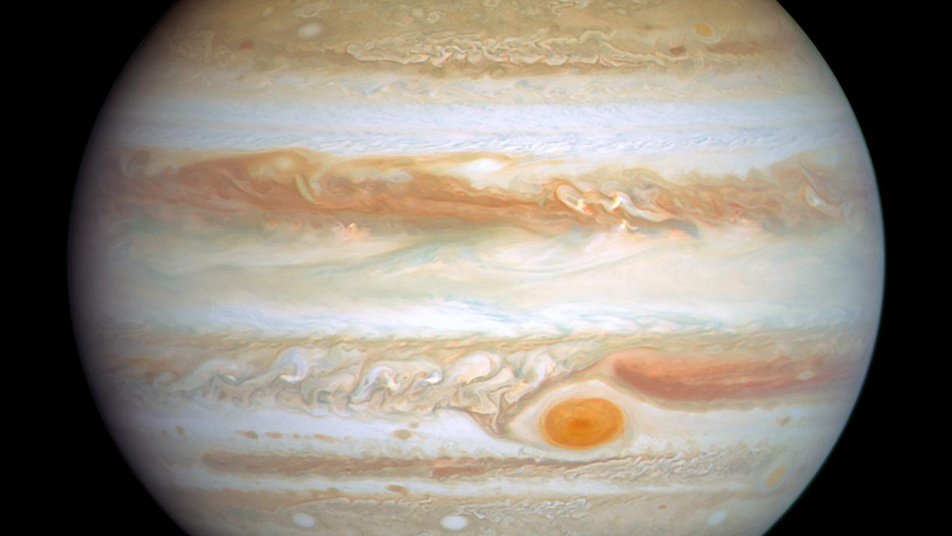
Which is greater?
Jupiter vs the mass of all other planets

Slide 19
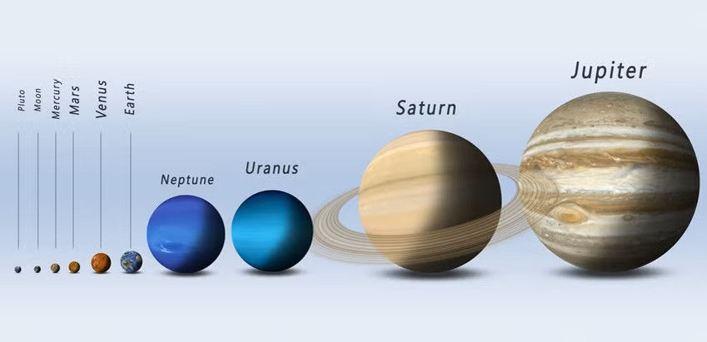
Jupiter
Other Planets | Mass
MERCURY | 0
VENUS | 5
EARTH | 6
MARS | 1
SATURN | 568
URANUS | 87
NEPTUNE | 102
Total | 769
Jupiter vs the mass of all other planets

Slide 20
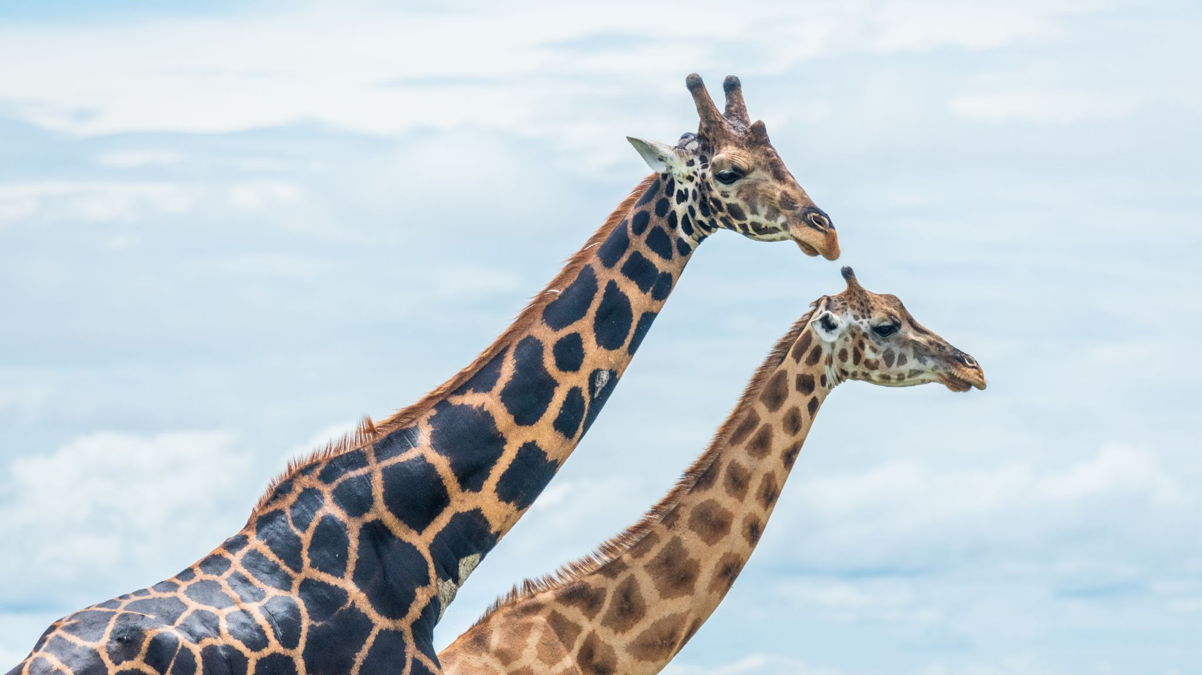
Which is taller?
Giraffe on its tippy toes vs tallest human pyramid

Slide 21
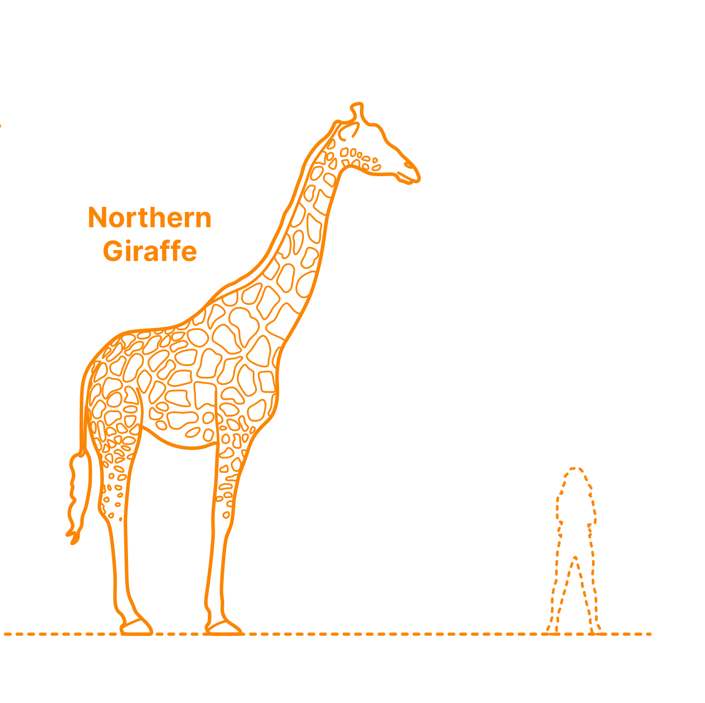
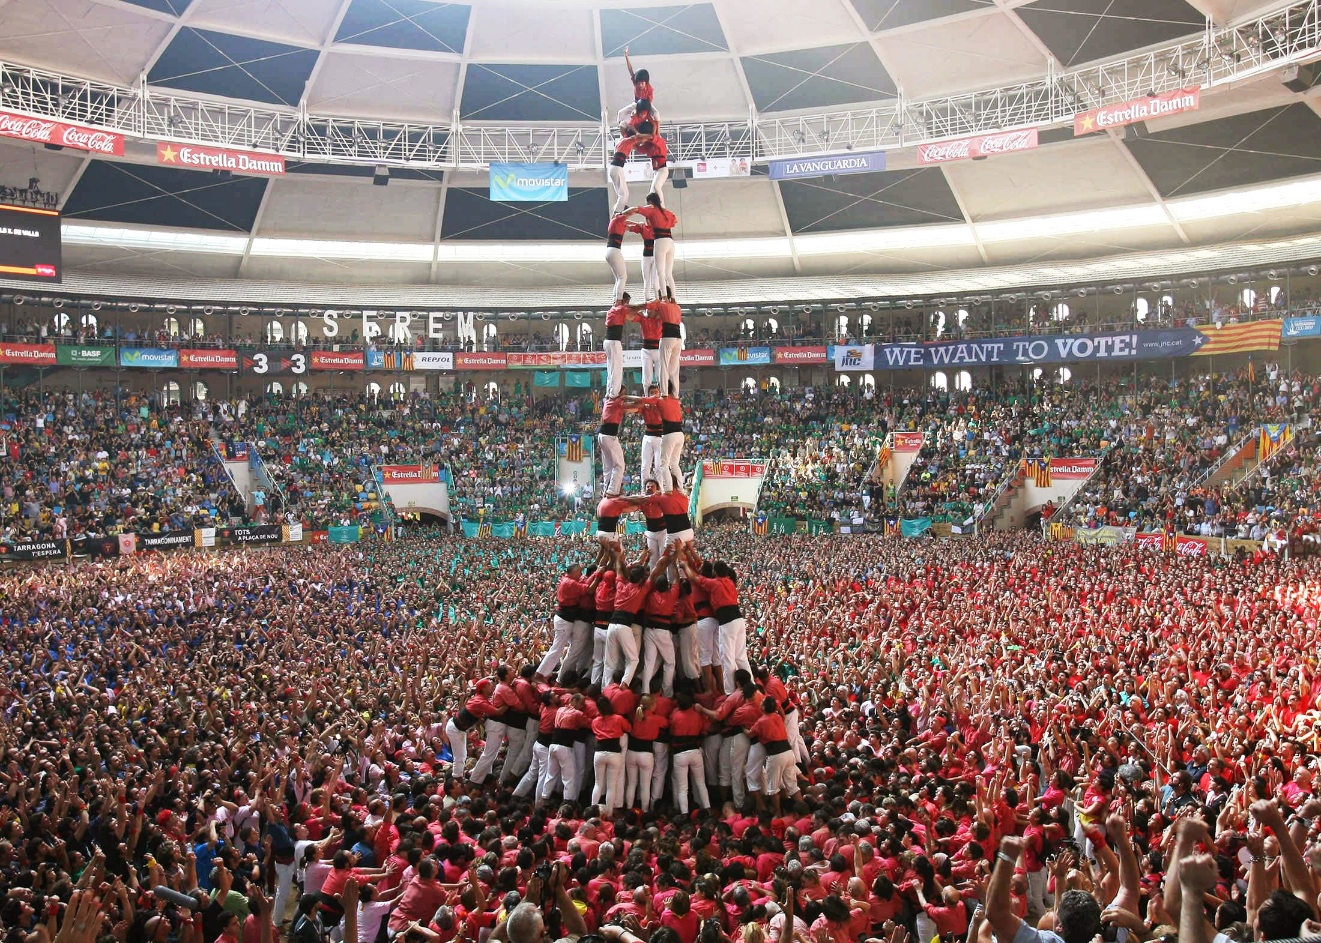
Tallest Human Pyramid
Giraffe = 5 m
tallest human pyramid = 12 m

